Slide 1
CSE 1121 Structured and Object Oriented Programming Language Department of Computer Science and Engineering DUET, Gazipur-1700
Md. Abu Bakkar Siddique
Lecturer, Department of CSE, DUET
Room # 7024, New Academic Building
Phone/Mobile: +880249274034-53 Ext: 3281, +8801944275646
Email: absiddique@duet.ac.bd, absduet@gmail.com

Slide 2
Lecture 03(C Expressions & Operators)
Outline
C operators
Operator Precedence & Associativity
C Expression Evaluation
Type Conversion in Expressions

Slide 3
C Operators
An operator is a symbol that tells the computer to perform certain mathematical or logical manipulations.
Operators used in programs to manipulate data & variables
C is very rich in built-in operators, classified into following number of categories:
Arithmetic
Relational
Logical
Bitwise
Assignment
Increment/Decrement
Conditional

Slide 4
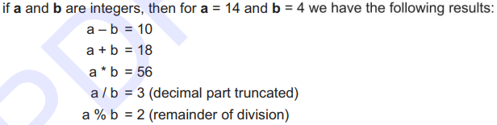
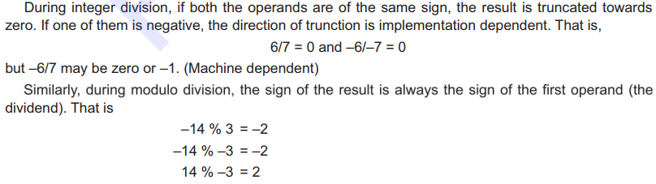
C Operators - Arithmetic Operators
Following table lists C’s arithmetic operators:
Operator | Meaning
+ | Addition or unary plus
- | Subtraction or unary minus
* | Multiplication
/ | Division
% | Modulus
Integer division(/) truncates any fractional part (remainder).
Modulus operator (%) can not used be used on floating-point data. During modulus operation, sign of the result is always the sign of the first operand. .
e.g. 5/2 -> 2 -11%2 -> -1 11/-2 -> 1

Slide 5

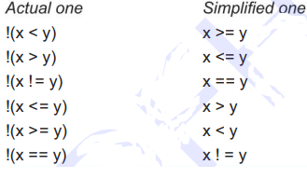
C Operators – Relational Operators
Relational refers to the relationships that values can have with one another.
Expressions that use relational operators return 0 for false & 1 for true.
Operator | Meaning
> | Is greater than
>= | Is greater than or equal to
< | Is less than
<= | Is less than or equal to
== | Is equal to
!= | Is not equal to

Slide 6
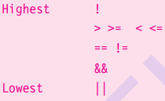
C Operators – Logical Operators
Logical refers to the ways relationships can be connected.
Expressions that use logical operators return 0 for false & 1 for true.
Operator | Meaning
&& | AND
|| | OR
! | NOT
The truth table for logical operators is shown below:
P | Q | P && Q | P || Q | !P
0 | 0 | 0 | 0 | 1
0 | 1 | 0 | 1 | 1
1 | 1 | 1 | 1 | 0
1 | 0 | 0 | 1 | 0

Slide 7
C Operators – Bitwise Operators
Bitwise operation refers to testing, setting, or shifting the actual bits in a byte or word, which correspond to the standard char or int data types.
Bitwise operator can not be used on float, double, long double or void data types.
Operator | Meaning
& | AND
| | OR
^ | XOR
~ | One’s Complement (NOT)
>> | Shift right
<< | Shift left

Slide 8
C Operators – Assignment Operator
“ = ” used to assign the result of an expression to a variable. General form: variable_name = expression;
Multiple assignments: x = y = z = 0;
Compound assignments: The statement of the form var = var
operator expression can be written as var operator = expression
e.g. x = x + 1 can written as x += 1
Operator | Example
+= | X += 1
-= | X -= 1
*= | X *= Y
/= | X /= Y
%= | X %= Y

Slide 9
C Operators – Increment/Decrement
“ ++ ‟ adds 1 to its operand and " --‟ subtracts 1 from its operand.
x = x +1 is same as ++x and x = x – 1 same as --x
Both the increment and decrement operator may either in prefix or
postfix form.
When postfix (x++ or x--) is used with a variable in an expression, the expression is evaluated first using the original value of the variable and then the variable is incremented (or decremented) by one.
When prefix (++x or --x) is used in an expression, the variable is incremented (or decremented) first and then the expression is evaluated using new value of the variable.

Slide 10
C Operators – Conditional Operator
Also called ternary operator “ ?: ”
General form: exp1 ? exp2 : exp3
operation same as if-then-else statement
a = 10;
b = 15;
If (a > b) x = a;
else
x = b;
a = 10;
b = 15;
x = (a > b) ? a : b;

Slide 11

C Operators – Special Operator

Slide 12
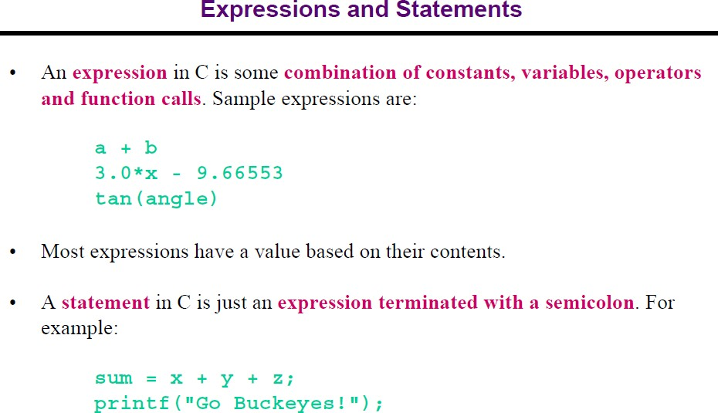

Slide 13
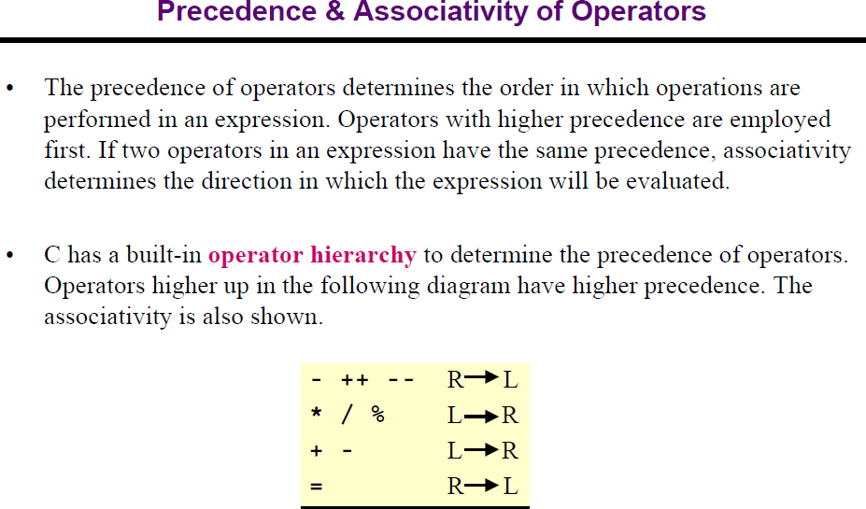

Slide 14
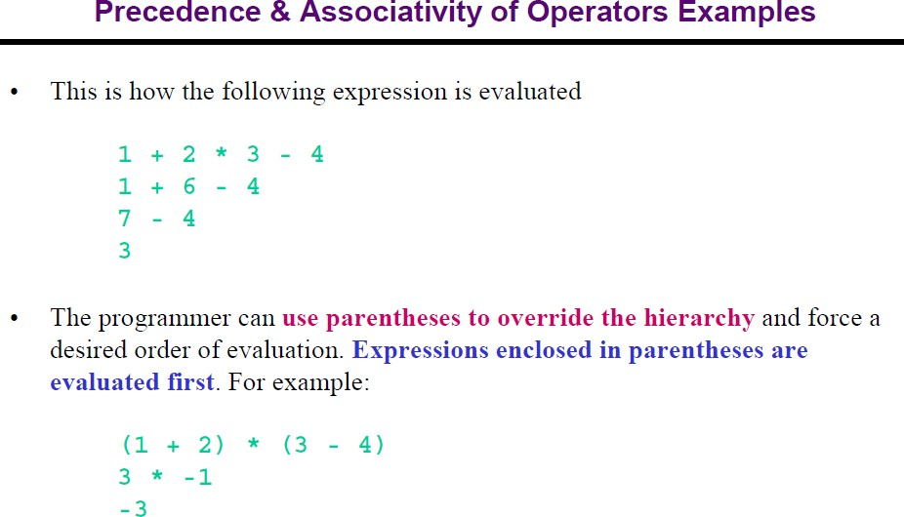

Slide 15
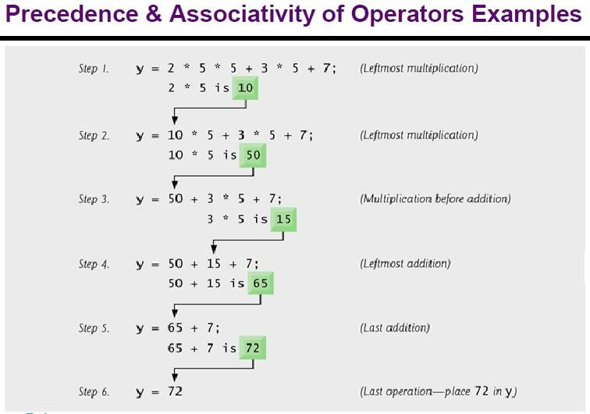
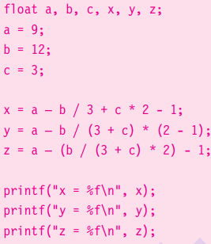

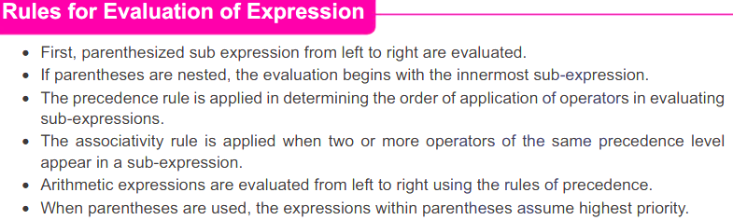

Slide 16
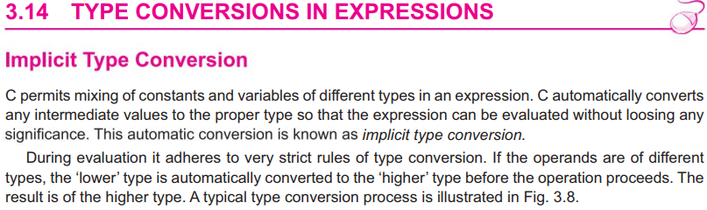
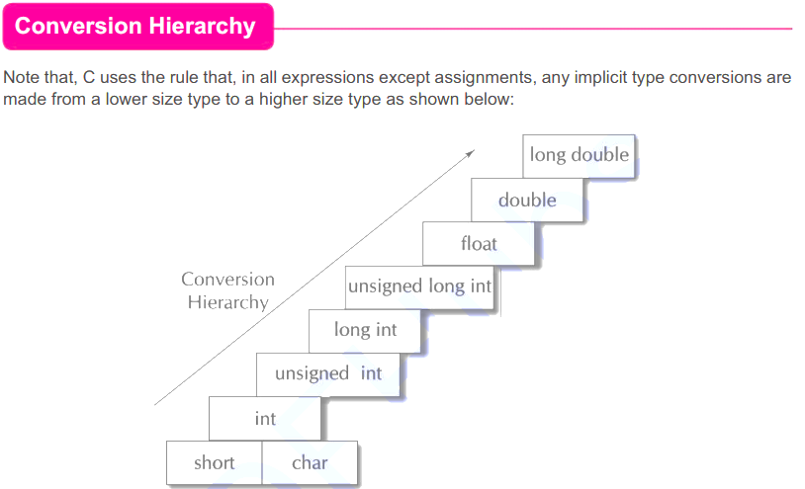
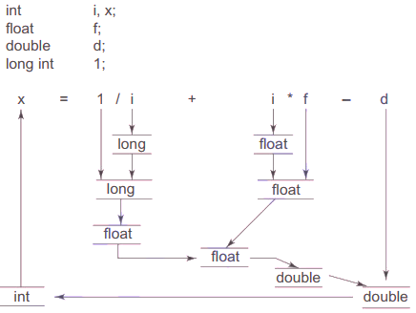
C Type Conversion

Slide 17

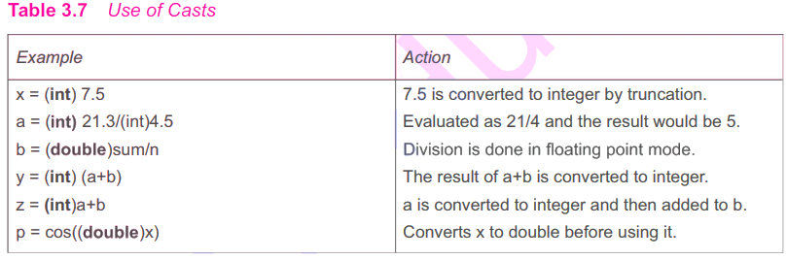
C Type Conversion

Slide 18
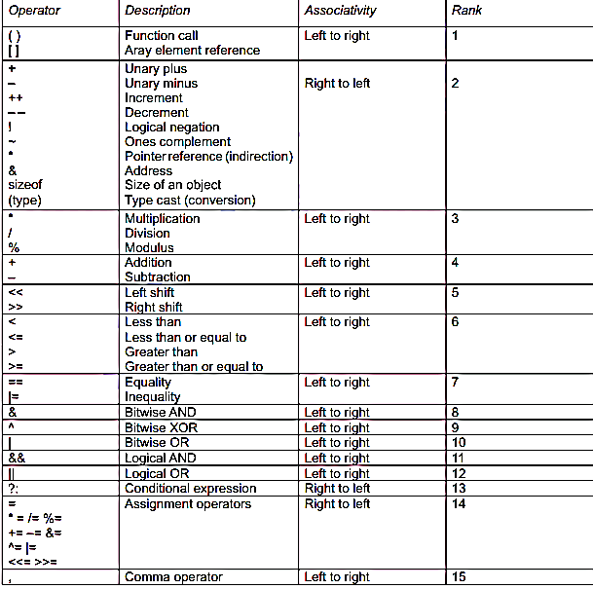

Slide 19

Any Question?

Slide 20
Thank You All

